Slide 1
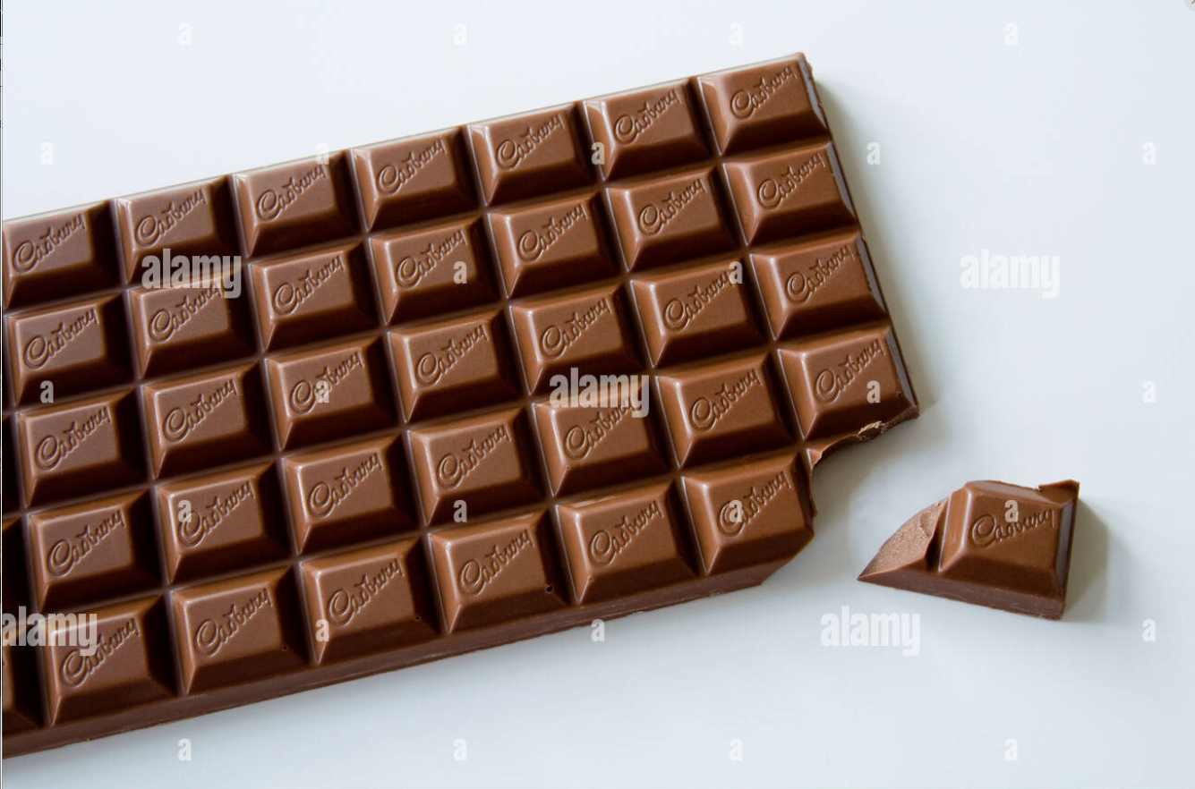
DSE 2256 DESIGN & ANALYSIS OF ALGORITHMS Lecture 16 Decrease-and-Conquer: Topological Sorting
Instructors:
Dr. Savitha G, Assistant Professor, DSCA, MIT, Manipal
Dr. Abhilash K. Pai, Assistant Professor, DSCA, MIT, Manipal
Courtesy : www.alamy.com

Slide 2
Recap of L14 & L15
Decrease-and-Conquer
Reduce problem instance to smaller instance of the same problem
Solve smaller instance.
Extend solution of smaller instance to obtain solution to original instance

Slide 3
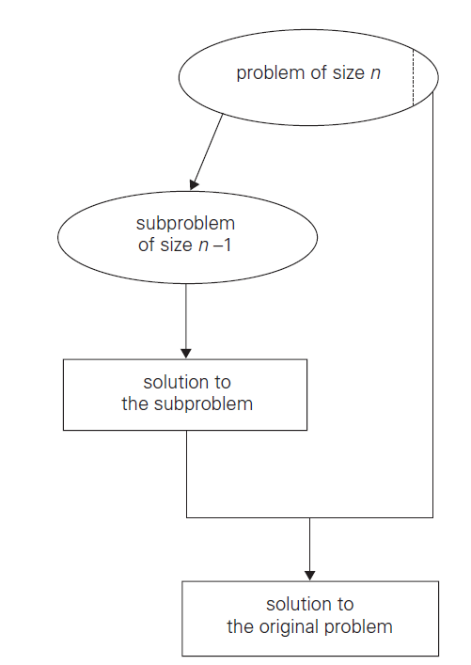
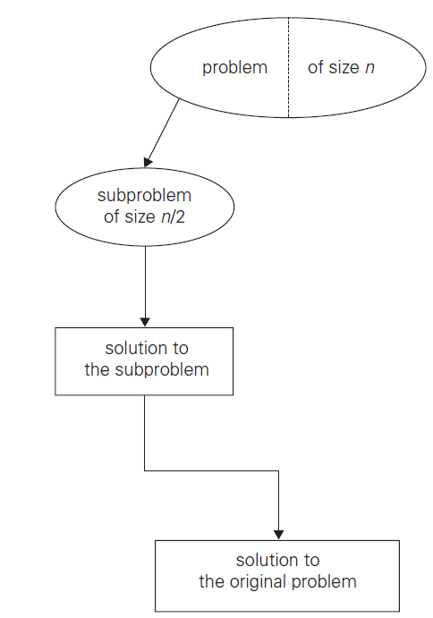
Recap of L14 & L15
Types of Decrease-and-conquer techniques:
Decrease by a constant (usually by 1):
Insertion sort
Topological sorting
Decrease by a constant factor (usually by half):
Binary search
Variable-size decrease
Euclid’s algorithm

Slide 4
Recap of L14 & L15
Many problems require processing all graph vertices (and edges) in systematic fashion
Graph traversal algorithms:
Depth-first search (DFS)
Data structure used -Stack
Breadth-first search (BFS)
Data structure used - Queue

Slide 5
Directed Acyclic Graph (DAG)
A dag: a directed acyclic graph, i.e. a directed graph with no (directed) cycles
a DAG not a DAG
Arise in modeling many problems that involve prerequisite​ constraints (construction projects, document version control)​
​Vertices of a dag can be linearly ordered so that for every edge, its starting vertex is listed before its ending vertex (topological sorting).
Being a dag is also a necessary condition for topological sorting to be possible. ​
a
b
a
b
c
d
c
d

Slide 6
Topological Sorting
​Vertices of a DAG can be linearly ordered so that for every edge its starting vertex is listed before its ending vertex is called topological sorting.
Two methods to implement: DFS based topological sorting, Source removal algorithm
Example:
{C1,C2,C3,C4,C5} – are set of five courses a part-time student has to take in the degree program
Courses should meet the following prerequisites:
C1 and C2 have no prerequisites
C3 requires C1 and C2
C4 requires C3
C5 requires C3 and C4
Student can take only one course per term.
In which order should the student take the courses?

Slide 7
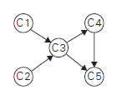


DFS-based algorithm for topological sorting​
Solution:
Perform DFS traversal, noting the order of vertices, popped off the traversal stack​
Reverse order solves topological sorting problem​
Back edges encountered?→ NOT a dag!
Prerequisites:
C1 and C2 have no prerequisites
C3 requires C1 and C2
C4 requires C3
C5 requires C3 and C4

Slide 8
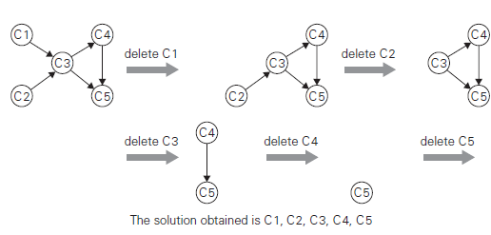
Source removal algorithm for Topological Sorting
Repeatedly identify and remove a source (a vertex with no incoming edges) and all the edges incident to it until either no vertex is left or there is no source among the remaining vertices (not a dag)​

Slide 9
Notes on Topological Sorting
Algorithm for directed graph or digraph
A directed graph should be DAG (Directed Acyclic Graph)
Topological sorting implemented by two methods
DFS based algorithm
Source removal algorithm
Topological sorting may have several alternative solutions.
Solution obtained by the DFA based algorithm and source removal are different.

Slide 10
Problem
Apply the DFS-based algorithm and Source removal algorithm to solve the topological sorting problem for the following digraph.
a
b
d
c

Slide 11
Thank you!
Any queries?
Notes:
Cannot find exact value and can only be approximated

